Slide 1
Threat Modeling - Threat Candidate Triage
Charles Wilson
Staff Product Cybersecurity Architect
version 3
2025-06-24
Notes:
Script:
I'm Charles Wilson, Staff Product Cybersecurity Architect at Torc Robotics.
This presentation will cover threat modeling - threat candidate triage.

Slide 2
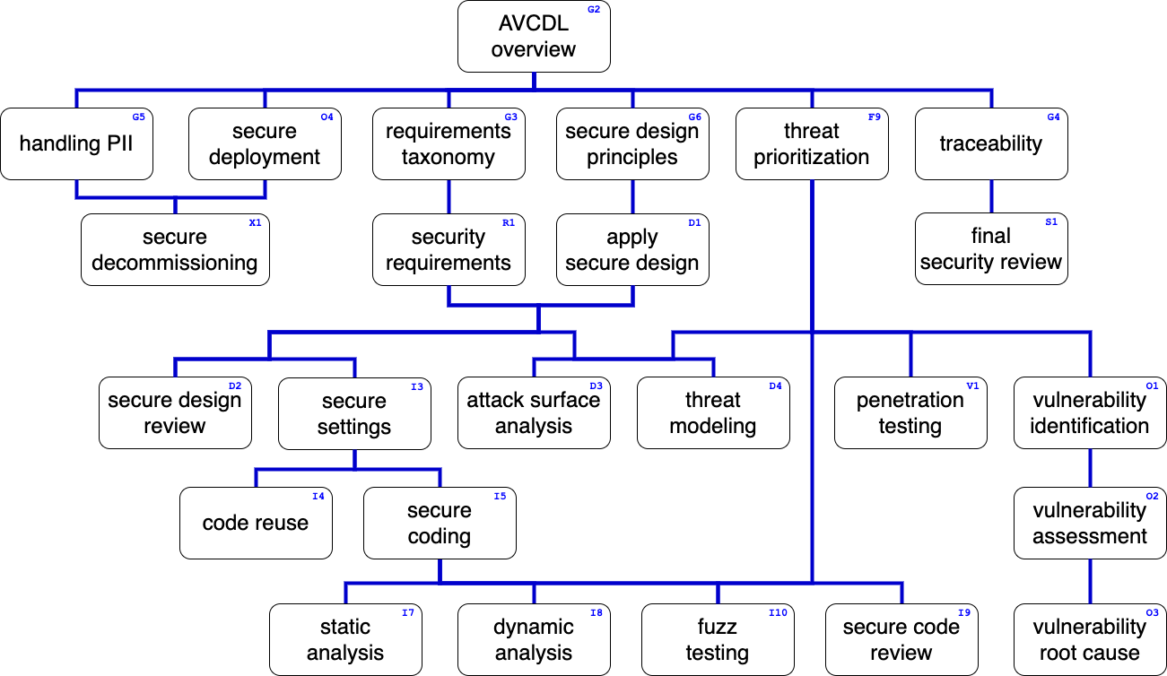
Training Path
Notes:
Script:
Here’s the overall AVCDL training path.
If you're taking this training, it's assumed that you've already completed the AVCDL overview training,
and that you’ve also completed the
requirements taxonomy
security requirements
secure design principles
apply secure design
and
threat prioritization plan training.
Additionally, you should have completed the
threat modeling overview
model creation
and
model analysis trainings.
This training will cover threat candidate triage.

Slide 3
Introduction
Notes:
Script:
Before getting into threat candidate triage, let's review where it fits in the overall threat modeling process.

Slide 4
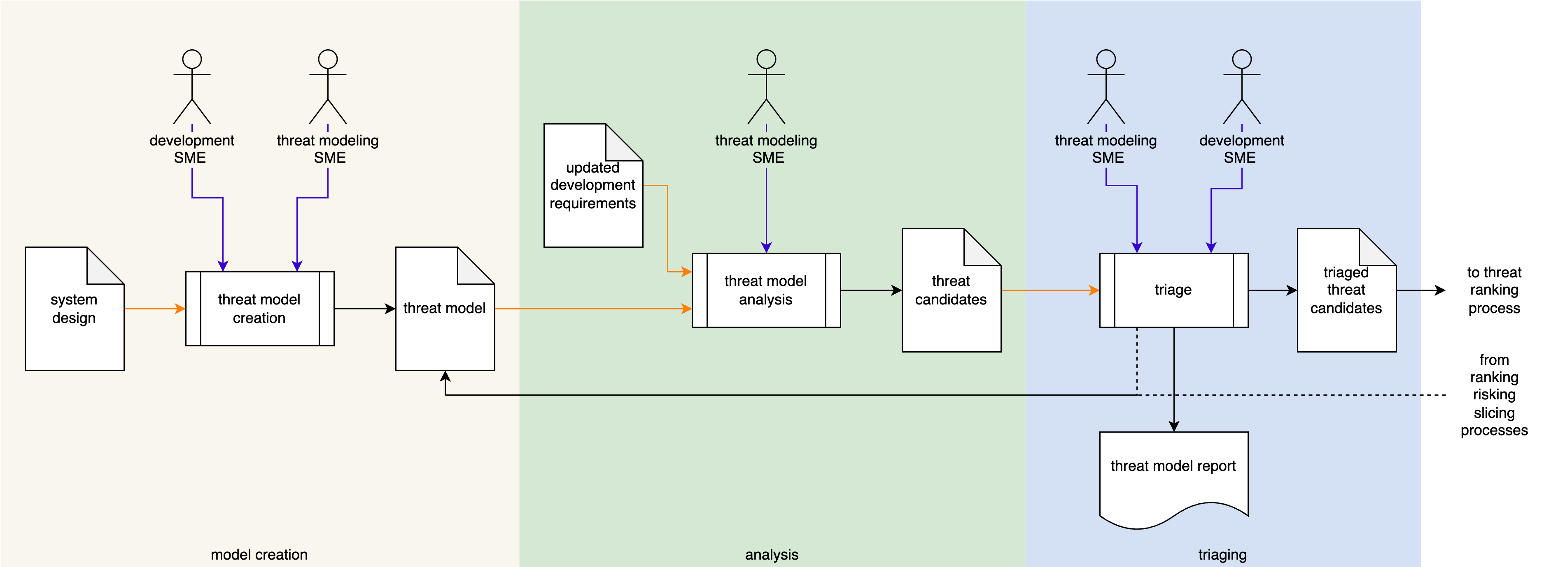
Threat Modeling Process
Notes:
Script:
Here’s the threat modeling process with its three individual activities,
model creation
model analysis
and
threat candidate triage
Let’s consider the triage activity.

Slide 5
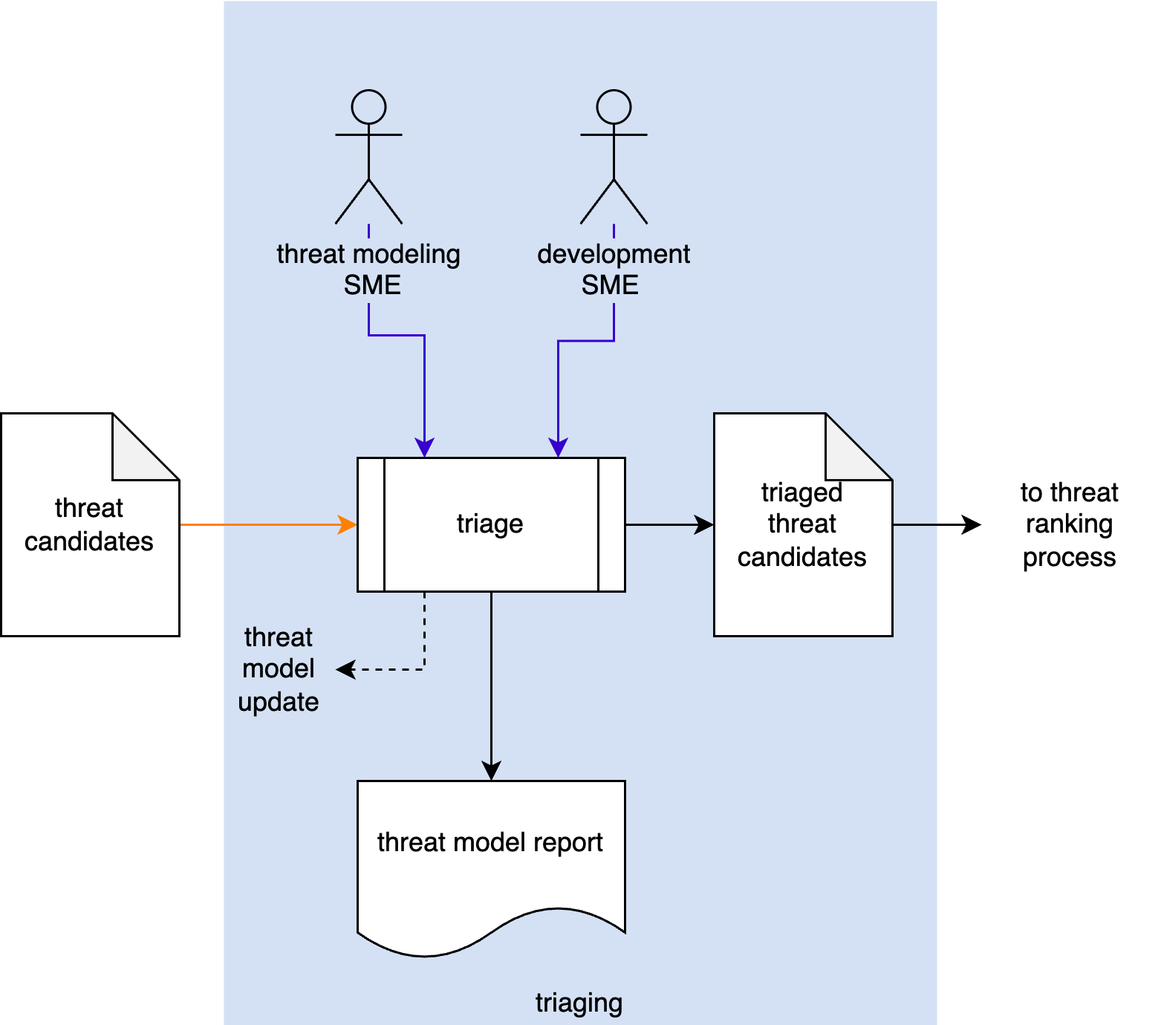
Threat Candidate Triage Activity
Notes:
Script:
In the threat candidate triage activity,
[pause]
The threat modeling SME
[pause]
and the development SME
[pause]
take the list of threat candidates
[pause]
and review each to determine which are valid.
This results in the creation of
[pause]
a set of triaged threat candidates.
[pause]
These are sent along to the threat ranking activity within the threat prioritization process.
[break]
Once again returning to the NIST threat modeling lifecycle, we see that threat candidate triage activity corresponds to
[pause]
the identification activity of the lifecycle.
Now, some might argue that because we’re evaluating the candidates, this must mean that we're doing investigation.
That’s an interesting argument; however, we're not putting it through the formal threat prioritization process here.
This is a true triage where we're just eliminating those issues which are obviously not valid.

Slide 6
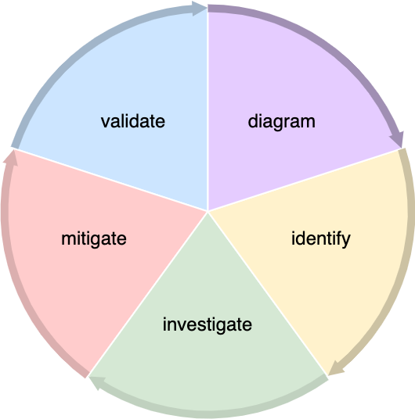
Threat Candidate Triage Activity
Notes:
Script:
In the threat candidate triage activity,
[pause]
The threat modeling SME
[pause]
and the development SME
[pause]
take the list of threat candidates
[pause]
and review each to determine which are valid.
This results in the creation of
[pause]
a set of triaged threat candidates.
[pause]
These are sent along to the threat ranking activity within the threat prioritization process.
[break]
Once again returning to the NIST threat modeling lifecycle, we see that threat candidate triage activity corresponds to
[pause]
the identification activity of the lifecycle.
Now, some might argue that because we’re evaluating the candidates, this must mean that we're doing investigation.
That’s an interesting argument; however, we're not putting it through the formal threat prioritization process here.
This is a true triage where we're just eliminating those issues which are obviously not valid.

Slide 7
Example
Notes:
Script:
Now let's work our way through the same example used in previous threat model trainings to illustrate how threat candidate triage is undertaken.

Slide 8
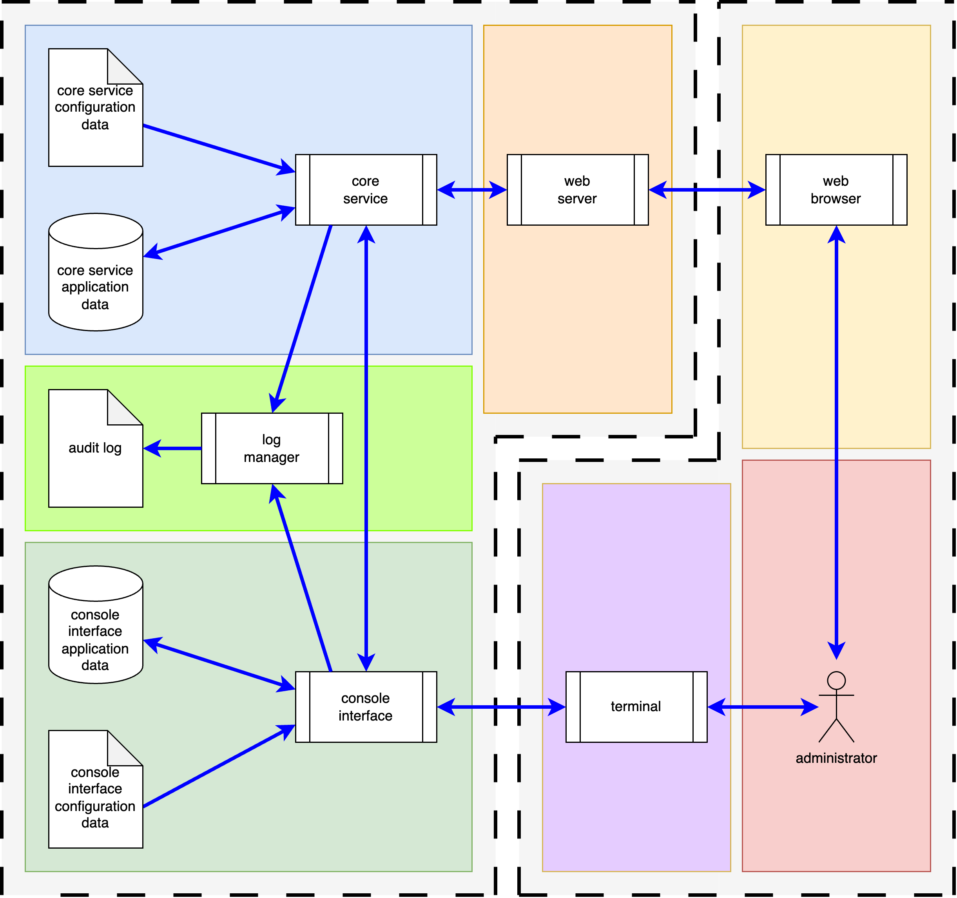
Block Diagram
Notes:
Script:
Recall that our example system is comprised of
a core service,
a web server,
and
a console interface.
These are connected to a web browser
and terminal
and eventually to an administrator who is interfacing with both.
Also recall that in the analysis of the threat model, it was recognized that the audit log, shown here, was left out.
So, this is the most up-to-date diagram for the system.
Let's look at what we did with it next.

Slide 9
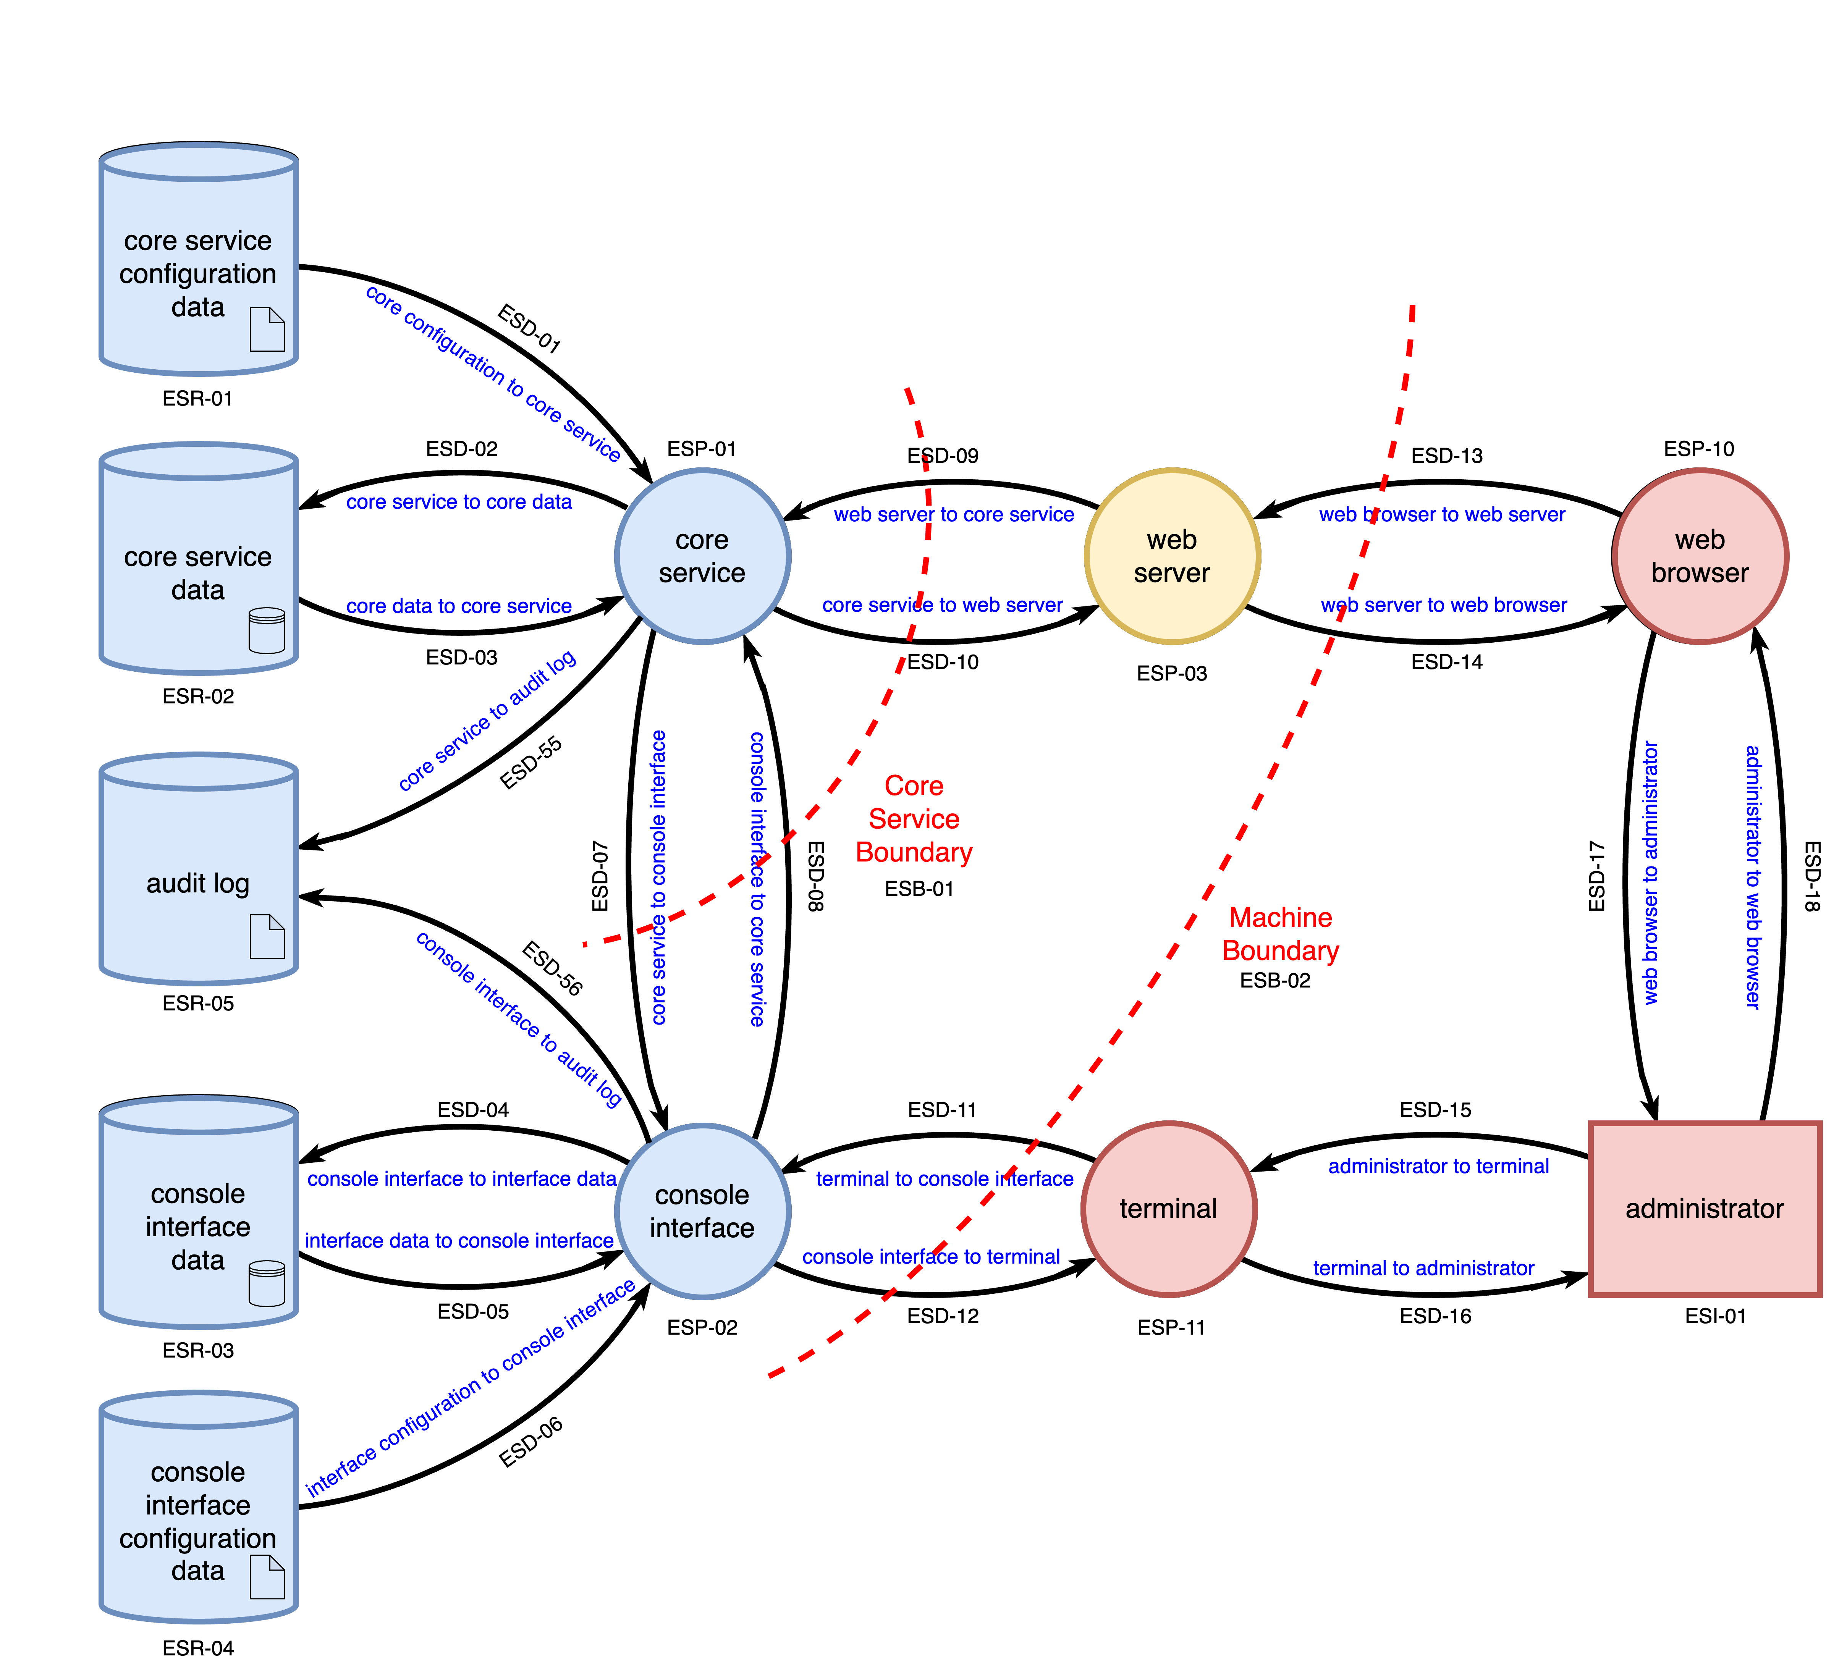
Level 1 DFD
Notes:
Script:
In the threat modeling activity, the system was taken and a series of DFDs were created.
This is the highest level one.
Recall that during the analysis activity, it was determined that the audit log had been left out.
Here we see it in place.
So, this is our most up to-date DFD for the example system.

Slide 10
Analysis
Notes:
Script:
Now let's review the analysis process applied to this model and the resultant issues generated from it.

Slide 11
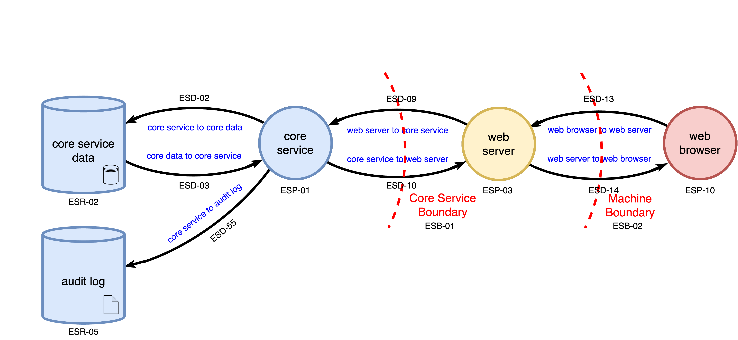
Normal Operation
Notes:
Script:
In the discussion of threat model analysis it was brought up that one should focus on those areas where you have differentials in trust.
In that training, the normal operation workflow, which we see here, was selected to illustrate the analysis methodology.

Slide 12
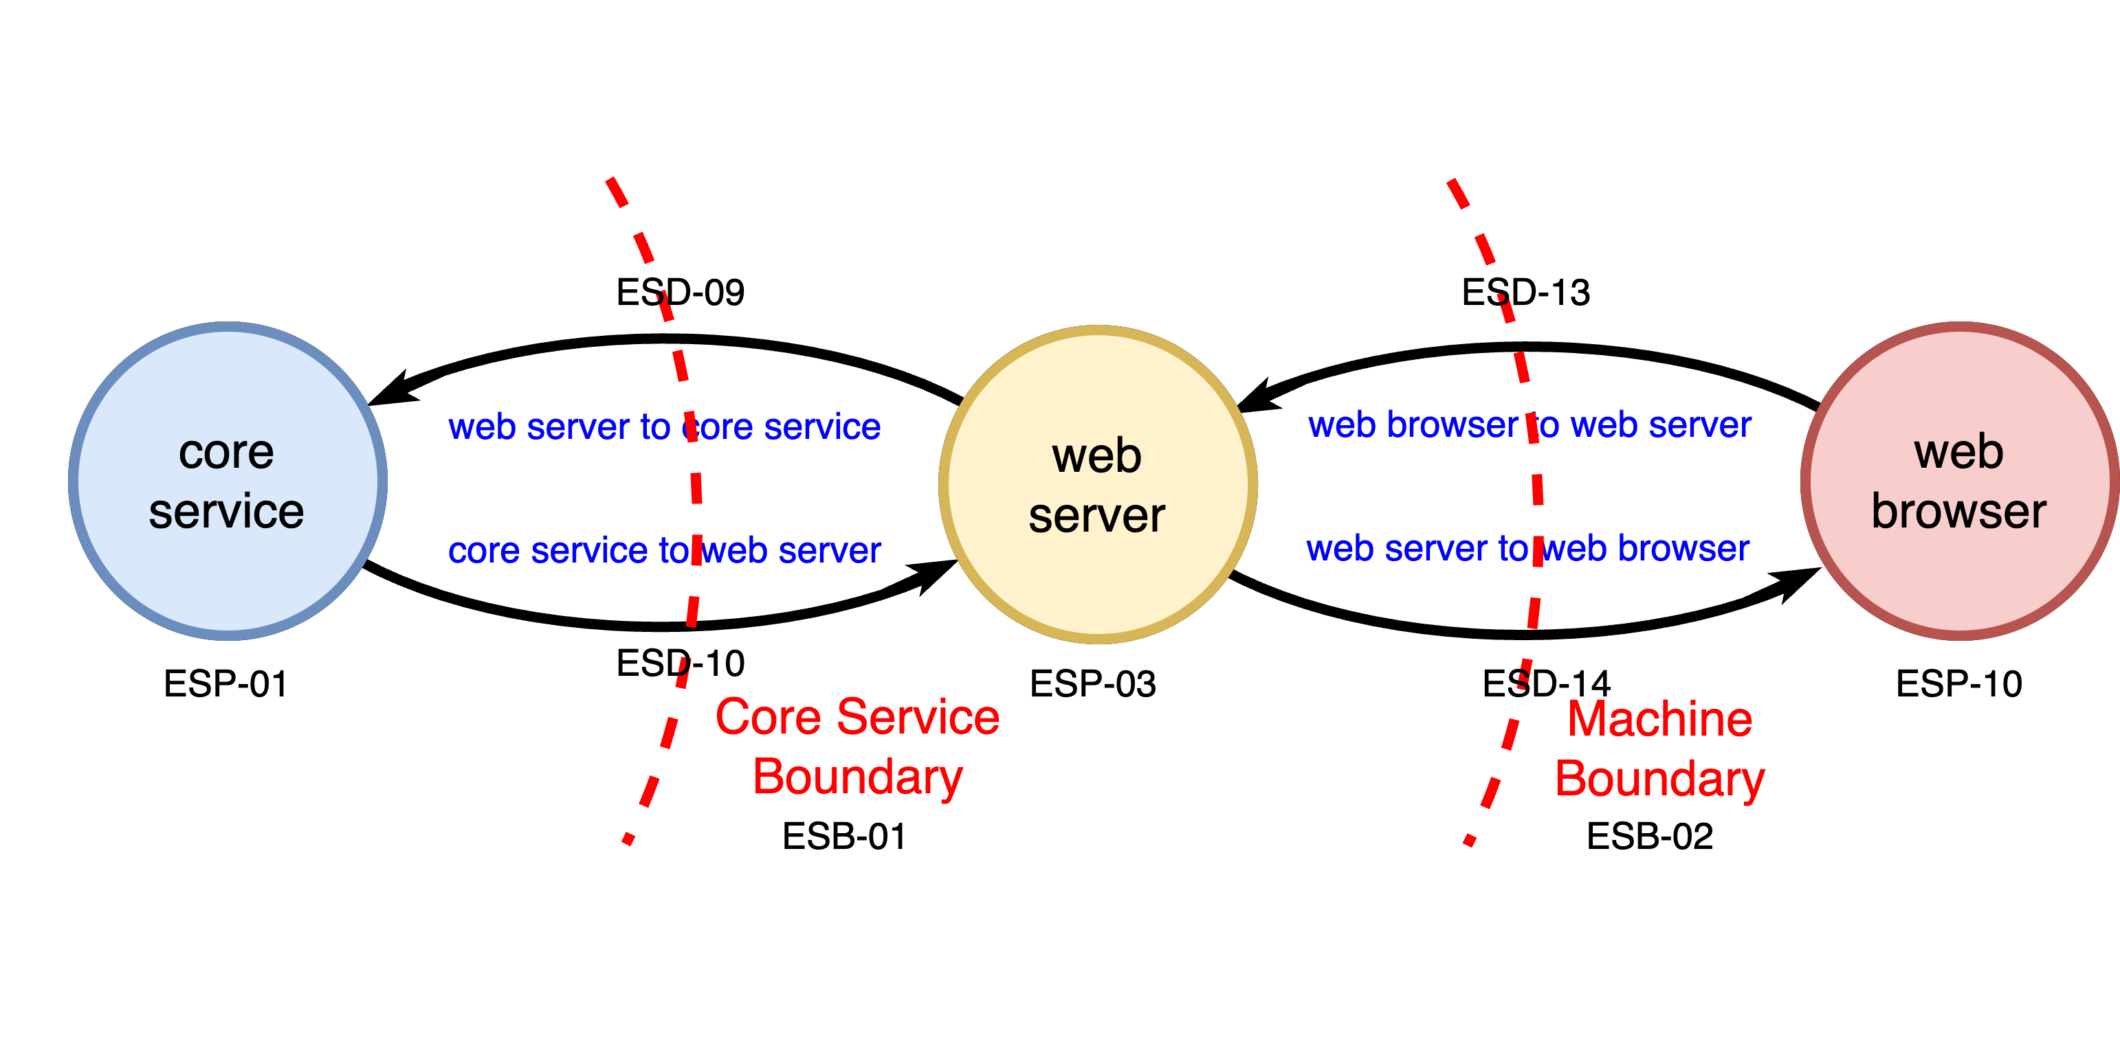
Focus on Trust Differential
Notes:
Script:
Within the normal operation flow, there are only three processes of interest.
These are
the core service (which is a fully trusted entity)
the web server (a third-party entity and therefore at a lower level of trust)
and finally
the web browser (a process external to the system and therefore untrusted).
Note that we have the two boundaries here,
the core service boundary between the core service and the web server,
and the machine boundary between the web server and the web browser.
These four data flows were then analyzed.

Slide 13
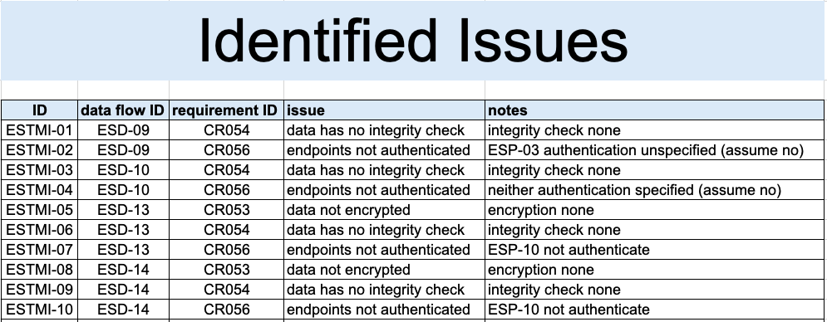
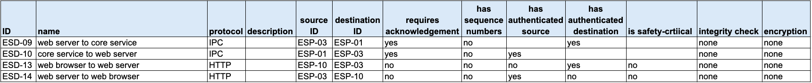
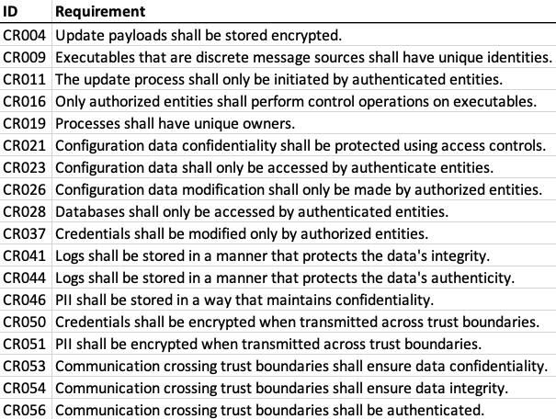
Analysis Results
Notes:
Script:
The analysis of these four data flows yielded ten issues.
They were violations of three cybersecurity requirements.
These identified issues are technically referred to as threat candidates.

Slide 14
Triage
Notes:
Script:
Now let’s consider how we’re going to triage the results of the analysis.

Slide 15
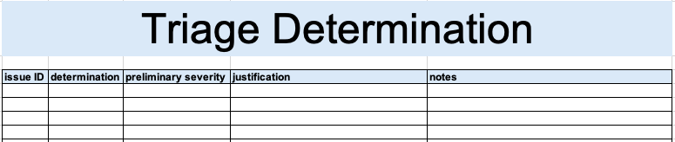
Methodology
Determination
Preliminary severity
Justification
Notes:
Script:
The methodology that we're going to employ to do the triage is straightforward.
We’ll take each of the issues; those threat candidates identified in the analysis activity; and review each to determine whether it’s valid.
This determination is the goal of the triage activity.
Once a determination has been made for a given threat candidate, then for valid cases, we may assign a preliminary severity.
And if it’s not valid, we’ll provide a justification as to why the issue is not valid.
Additionally, we can provide notes for those will be working with this information later.
Now let's look in detail at the values for the determination and severity fields.

Slide 16
Determination
Valid
Insufficient model
Non-issue
Notes:
Script:
The first step in deciding whether the issue needs to be dealt with or not is to make a determination regarding the threat candidate’s validity.
There are three different determinations that we can assign.
The first is that the issue is valid.
The analysis properly identified that there is a violation of a cybersecurity requirement.
If this is the case, we will assign a preliminary severity, if appropriate.
The next case is that we determine there to be an insufficiency in the model itself.
The analysis would not have yielded this issue had the model been correctly formed.
The model will need to be updated, and the analysis will need to be performed again.
Finally, we have non-issues.
These differ from valid and insufficient model because the issue itself, as stated, is valid.
The element model is correct and complete; however, it does not sufficiently capture the totality of the system.
This is an abstraction-level limitation.
Something else within the system renders this issue non-impactful.
Keep in mind that if the vast majority of the threat candidates are being determined to be invalid,
then there's a problem in the execution of the analysis, the triage process, and possibly in the model creation activity
And so, a cybersecurity SME should be very wary when a high number of either insufficient or non-issues show up during the triage process.

Slide 17
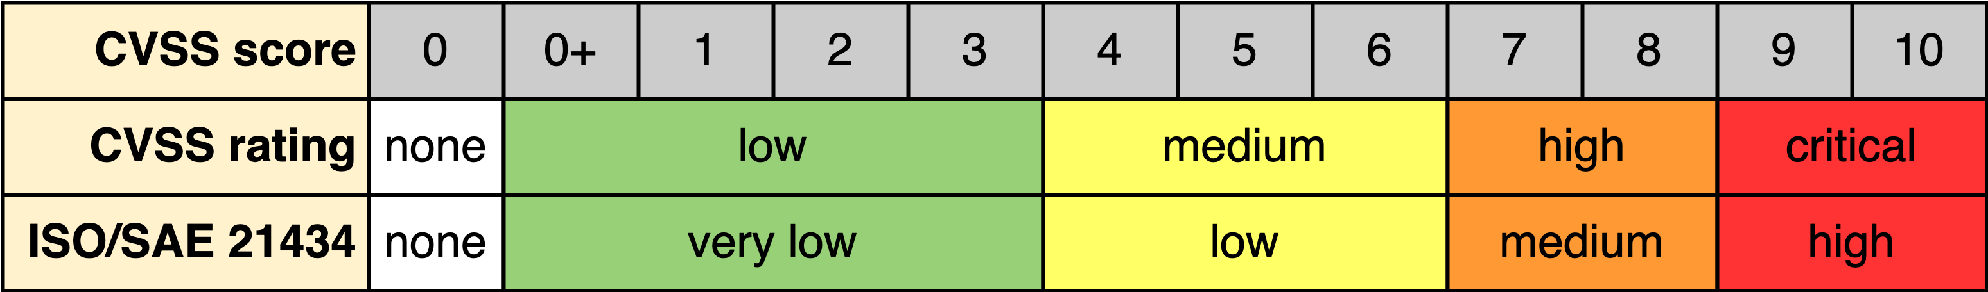
Preliminary Severity
Notes:
Script:
For issues that have been determined to be valid a preliminary severity may be assigned.
Keep in mind that this is an optional step.
It should only be done in cases where there is an issue of importance.
If we're dealing with a run-of-the-mill issue that can go through the threat prioritization process without having to be pushed to the front of the queue because it's blatant that this needs to be corrected, then assignment of a preliminary severity may be skipped.
[pause]
Note that the template provided for threat modeling - threat candidate triage does not include a particular list of values that should be used for the preliminary severity.
The reason for this is easy to illustrate if consider the following.
Here's the CVSS score.
It has values ranging from 0 to 10.
Alternately, we can look at the CVSS rating.
It’s values are low, medium, high, and critical.
We've added it a true 0 (or none) here because that makes things easier when dealing with automation.
These aren’t our only choices for the severity, also known as the rank.
If we look at what's specified in ISO/SAE 21434, for example, we have very low, low, medium, and high.
Unlike the CVSS ratings, ISO/SAE 21434 doesn’t specify what the values should be aligned to. The AVCDL chooses to align them to the CVSS rating ranges.
Your organization might use something completely different.
You might have three-value severity: low, medium, and high.
Or simply a bug bar: bad or not bad.
These are very organizationally dependent things.
And so, this is provided only as examples of what may be used.
Don't presume that this information is going to be consistent from organization to organization.

Slide 18
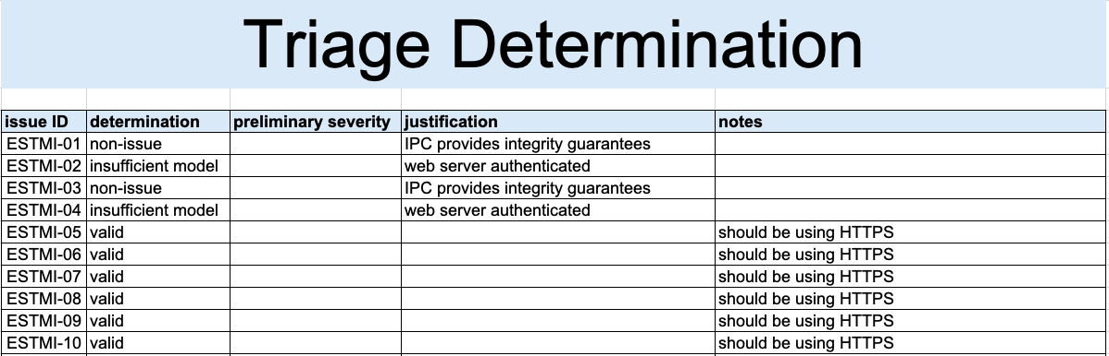
Example Triage
Notes:
Script:
Now let's go through the exercise of doing triage.
And we'll start with the identified issues, the threat candidates.
We'll bring in the corresponding DFD.
For reference, we'll also bring in the text of the cybersecurity requirements that are at play here.
And now, let's look at the issues one at a time, and talk about the triage determination that we make on them.
For the first one, we're dealing with ESD-09, the data flow that goes from the web server to the core service.
The requirement we're violating is that we don't have data integrity.
And in fact, there is no integrity check stated in the model metadata.
This is a non-issue, because the IPC protocol used provides an integrity guarantee.
And so that takes that issue out of consideration.
[pause]
The second issue is on the same data flow.
What we're saying here is that we have unauthenticated end points, specifically the web server.
We know that the core service is authenticated because it is the trusted part of the element.
As you can see in the notes, for ESP-03, which is the web server, authentication is unspecified and assumed no.
Our determination upon consultation with the development SME is that this is a model insufficiency issue.
We know that the web server is authenticated.
Now, it's not necessary to go into how it's authenticated or why it's authenticated.
This is a model analysis.
The actual implementation is not the focus on here.
Suffice it to say that this is not an issue because we have a model insufficiency.
[pause]
For the third issue we're dealing with data flow ESD-10, which is from the core service to the web server.
The requirement that's violated here is again one of data integrity, and it's the same issue that we had with the first issue.
Since we have data integrity guarantees within the context of using the IPC, it's a non-issue.
[pause]
Issue four rounds out the issues between the core service and web server.
This one is again data flow ESD-10 from the core service to the web server, and it is the same issue as we had for issue two, we don't have authentication on both ends.
We've already established that the web server is authenticated, and so, like issue two, this one is a matter of an insufficient model.
[pause]
For the next six issues, we're going to consider them collectively.
The reason for that is that they stem from the same fundamental problem.
For issue five and eight, we have that the data going between the web server and web browser is not encrypted.
[pause]
For issues six and nine, we have that there's no integrity check again between the web server and web browser.
[pause]
Finally, issues seven and ten, we have that the endpoints aren't authenticated.
The web browser is an external unauthenticated entity.
[pause]
The underlying problem leading to all six of these issues is that we're using the HTTP protocol.
Now we’ve put in our notes a recommendation to use the HTTPS protocol.
This doesn't mean that there isn't some other mitigation that could be put in, but using the HTTP protocol without any security whatsoever can easily be remedied by adopting HTTPS.
[pause]
We could have assigned a preliminary severity to this last set of six, because they're taken together, they would have the same level of severity.
But there's no real motivation to do so given the fact that the only issue is that that the communications protocol that's been chosen is inappropriate for what we want to accomplish in the context of cybersecurity.

Slide 19
Recap
Notes:
Script:
That covers the basics of doing the threat modeling - threat candidate triage.
Now let’s review some of the important points that we covered in this training.

Slide 20
Summary
Address invalid issues first
Cluster like issues
Recommend best practice mitigation
Assign a preliminary severity if appropriate
Notes:
Script:
Address the invalid issues first.
Handling these is typically straightforward, as the development SME is probably going to be able to provide immediate rationale as to why things aren't valid.
Next, cluster like issues, because, generally speaking, the like issues are going to have similar treatments.
This is not always going to be the case, but in many cases it will.
As we saw the issues between the web server and web browser all stemmed from the same fundamental problem.
If you make a recommendation, do so based on best practices.
And remember that this is just guidance because the threat prioritization process, as its mitigation might be accomplished by several different treatments.
Finally, if it's appropriate, assign a preliminary severity to the issue.
Again, this is highly organizationally specific, and, it's going to be influenced by a number of factors, including the regulatory environment, where the issues are coming from, and who's going to be processing them.
Also, we know that once this goes into the threat prioritization process, the issue will be much more formally addressed.

Slide 21
Example Materials
<AVCDL>/source/reference_documents/working_material/example system/
Notes:
Script:
The materials that were used to cover this example are in this location shown here.
It's important to note that this includes the DFDs, as well as the threat model, model creation, issue tracking, and triage workbooks.

Slide 22
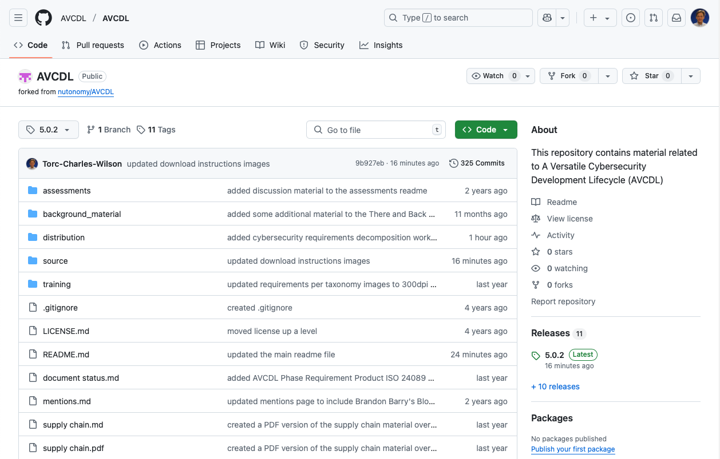
AVCDL on GitHub
https://github.com/AVCDL/AVCDL
Notes:
Script:
All AVCDL materials, both in source and distribution forms, are available on our GitHub site, as shown here.
Because of the size of the repository, it's recommended that you either clone the repository or download a ZIP archive of it, if you're not familiar with using git.
Instructions for downloading a ZIP archive are linked to on the repository’s front page.

Slide 23
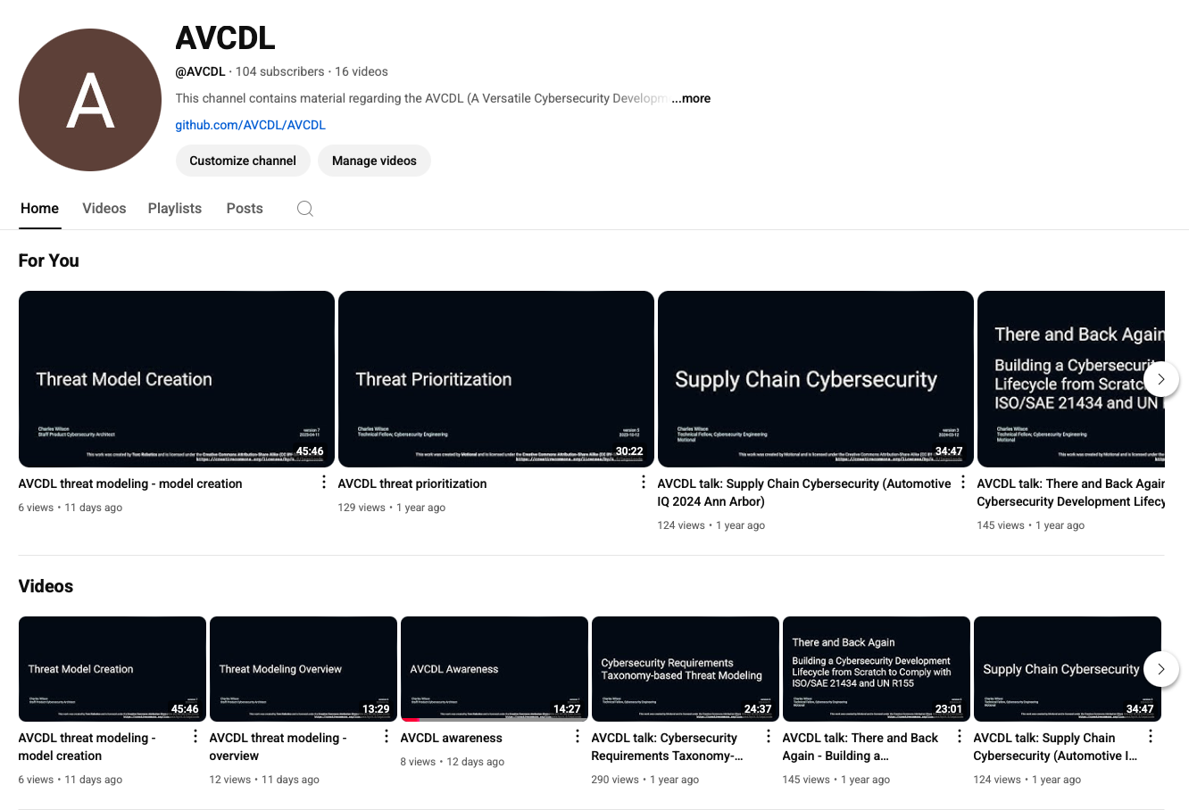
AVCDL on YouTube
https://youtube.com/@AVCDL
Notes:
Script:
Videos covering various aspects of the AVCDL are available on our YouTube channel, as shown here.
It's important to note that all AVCDL materials except for the introductory blog posts are intended for product cybersecurity engineering practitioners.

Slide 24
Next Steps
Notes:
Script:
This training is the last in the threat modeling sequence.
If you have completed all the trainings related to threat modeling, you can proceed to one of the other trainings at this level.
These are:
Attack Surface Analysis
Penetration Testing
and
Vulnerability Identification
Additionally, if you’ve completed Secure Coding and its prerequisites you can also proceed to
Static analysis
Dynamic analysis
Fuzz testing
and
Secure Code Review

Slide 25
References
AVCDL (GitHub)
https://github.com/AVCDL/AVCDL
Threat Modeling – Triage Procedure (AVCDL tertiary document)
Ranked / Risked Threat Report (AVCDL secondary document)
AVCDL threat modeling model template (AVCDL template)
AVCDL threat modeling analysis template (AVCDL template)
AVCDL threat modeling triage template (AVCDL template)
Guide to Data-Centric System Threat Modeling
https://csrc.nist.gov/publications/detail/sp/800-154/draft
Notes:
Script:
Here are references to the source material used in the creation of this presentation.
They'll also be included in the video description.
Additionally, this presentation’s source material will be provided on the AVCDL GitHub repository.

